Slide 1


Reading Minds from Eyes
Decoding Cognitive Load with Machine Learning and Oculometric Signal Analysis
SUPERVISOR: DR. XIAOFU JIN | UNIVERSITY OF STUTTGART

Slide 2
Presentation Agenda
I. Introduction & Motivation
IV. Feature Engineering
Cognitive states in HCI and Collaborative AI
Sliding windows and oculometric indicators
II. Theoretical Framework
V. Results & Analysis
Intrinsic vs. Extraneous Cognitive Load
Classification performance and generalizability
III. Methodology
VI. Conclusion
Eye-tracking dataset and signal processing
Summary of findings and future implications

Slide 3

01. Introduction & Motivation
Why decoding mental effort from eyes is a cornerstone for the next generation of adaptive AI.

Slide 4

The Challenge of Cognitive Load
Human-Computer Interaction
Predictive Intelligence
Adaptive systems must understand user mental states to prevent cognitive overload. Traditional methods are retrospective and subjective.
Current research focuses on distinguishing binary levels (Low vs. High). However, interventions require knowing the source of the load.
"Cognitive load reflects the mental effort required to perform a task... identifying different sources is qualitatively different for adaptive support."

Slide 5
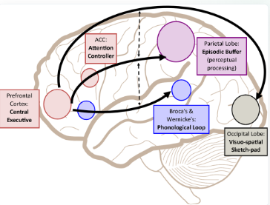
Decoding Dual Load Types
Intrinsic Load (Working Memory)
The inherent difficulty of the task itself. We model this through N-back memory tasks that challenge retention and processing capacity.
Extraneous Load (Visual Attention)
Load imposed by the presentation of information. We model this via visual search tasks requiring sustained attentional shifts.

Slide 6




Validating Ocular Measures
"Eye-tracking is one of the most reliable physiological indicators of cognitive workload, as confirmed by 579 surveyed HCI studies."
— Kosch et al. (2023)
Pupillary Activity
Saccadic Velocity
Fixation Duration

Slide 7
02. Data & Feature Engineering
Transforming raw gaze coordinates into high-dimensional predictive features.

Slide 8
The 7-State Cognitive Dataset
Label | Condition Name | Description / Task Type
0 | Rest | Baseline / No cognitive task
1 | WM Level 1 | Working Memory (N-back) - Low Difficulty
2 | WM Level 2 | Working Memory (N-back) - Medium Difficulty
3 | WM Level 3 | Working Memory (N-back) - High Difficulty
4 | VA Level 1 | Visual Attention (Search) - Low Difficulty
5 | VA Level 2 | Visual Attention (Search) - Medium Difficulty
6 | VA Level 3 | Visual Attention (Search) - High Difficulty

Slide 9
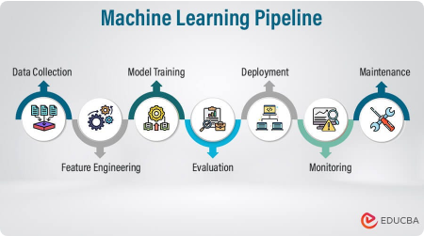
End-to-End Processing Pipeline
Raw Signal
Windowing
Features
ML Pipeline
Pupil diameter and gaze X/Y coordinates.
Sliding window extraction (512 samples/window).
Extraction of LHIPA, IPAS, and fixation stats.
Training Classifiers (SVM, RF, XGBoost).

Slide 10






Core Oculometric Indicators
LHIPA
Blink Rate
Saccades
Low/High Index of Pupillary Activity. Captures the ratio of slow to fast pupil changes.
Frequency of blinks per window. Lower rates are associated with intense cognitive effort.
Mean and peak velocity of rapid eye movements between fixation points.

Slide 11
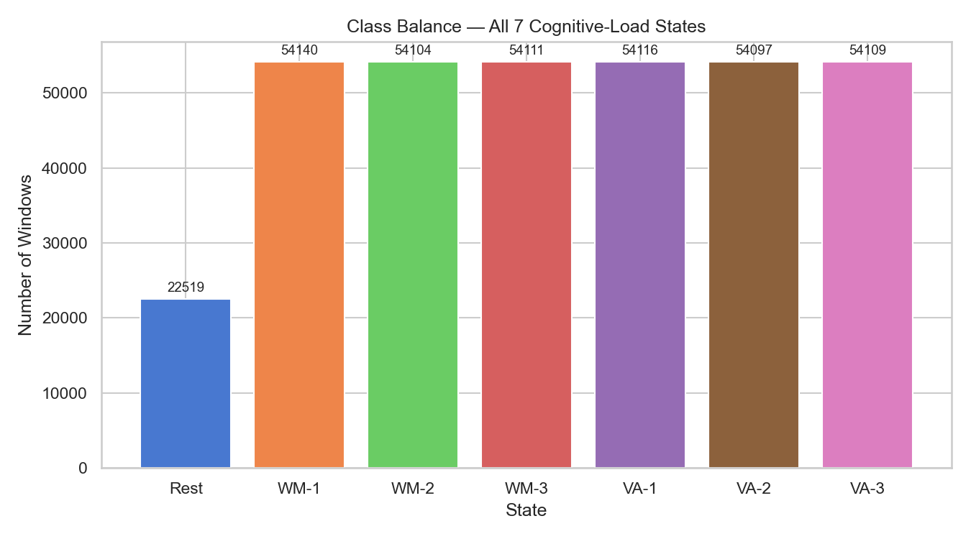
Exploratory Analysis: Class Balance
Our dataset consists of 347,196 windows. The balance across the 6 load states is nearly perfect (~54k windows each).
Ensures model isn't biased toward one difficulty level.
"Rest" state is underrepresented (22.5k), requiring careful metric selection.

Slide 12
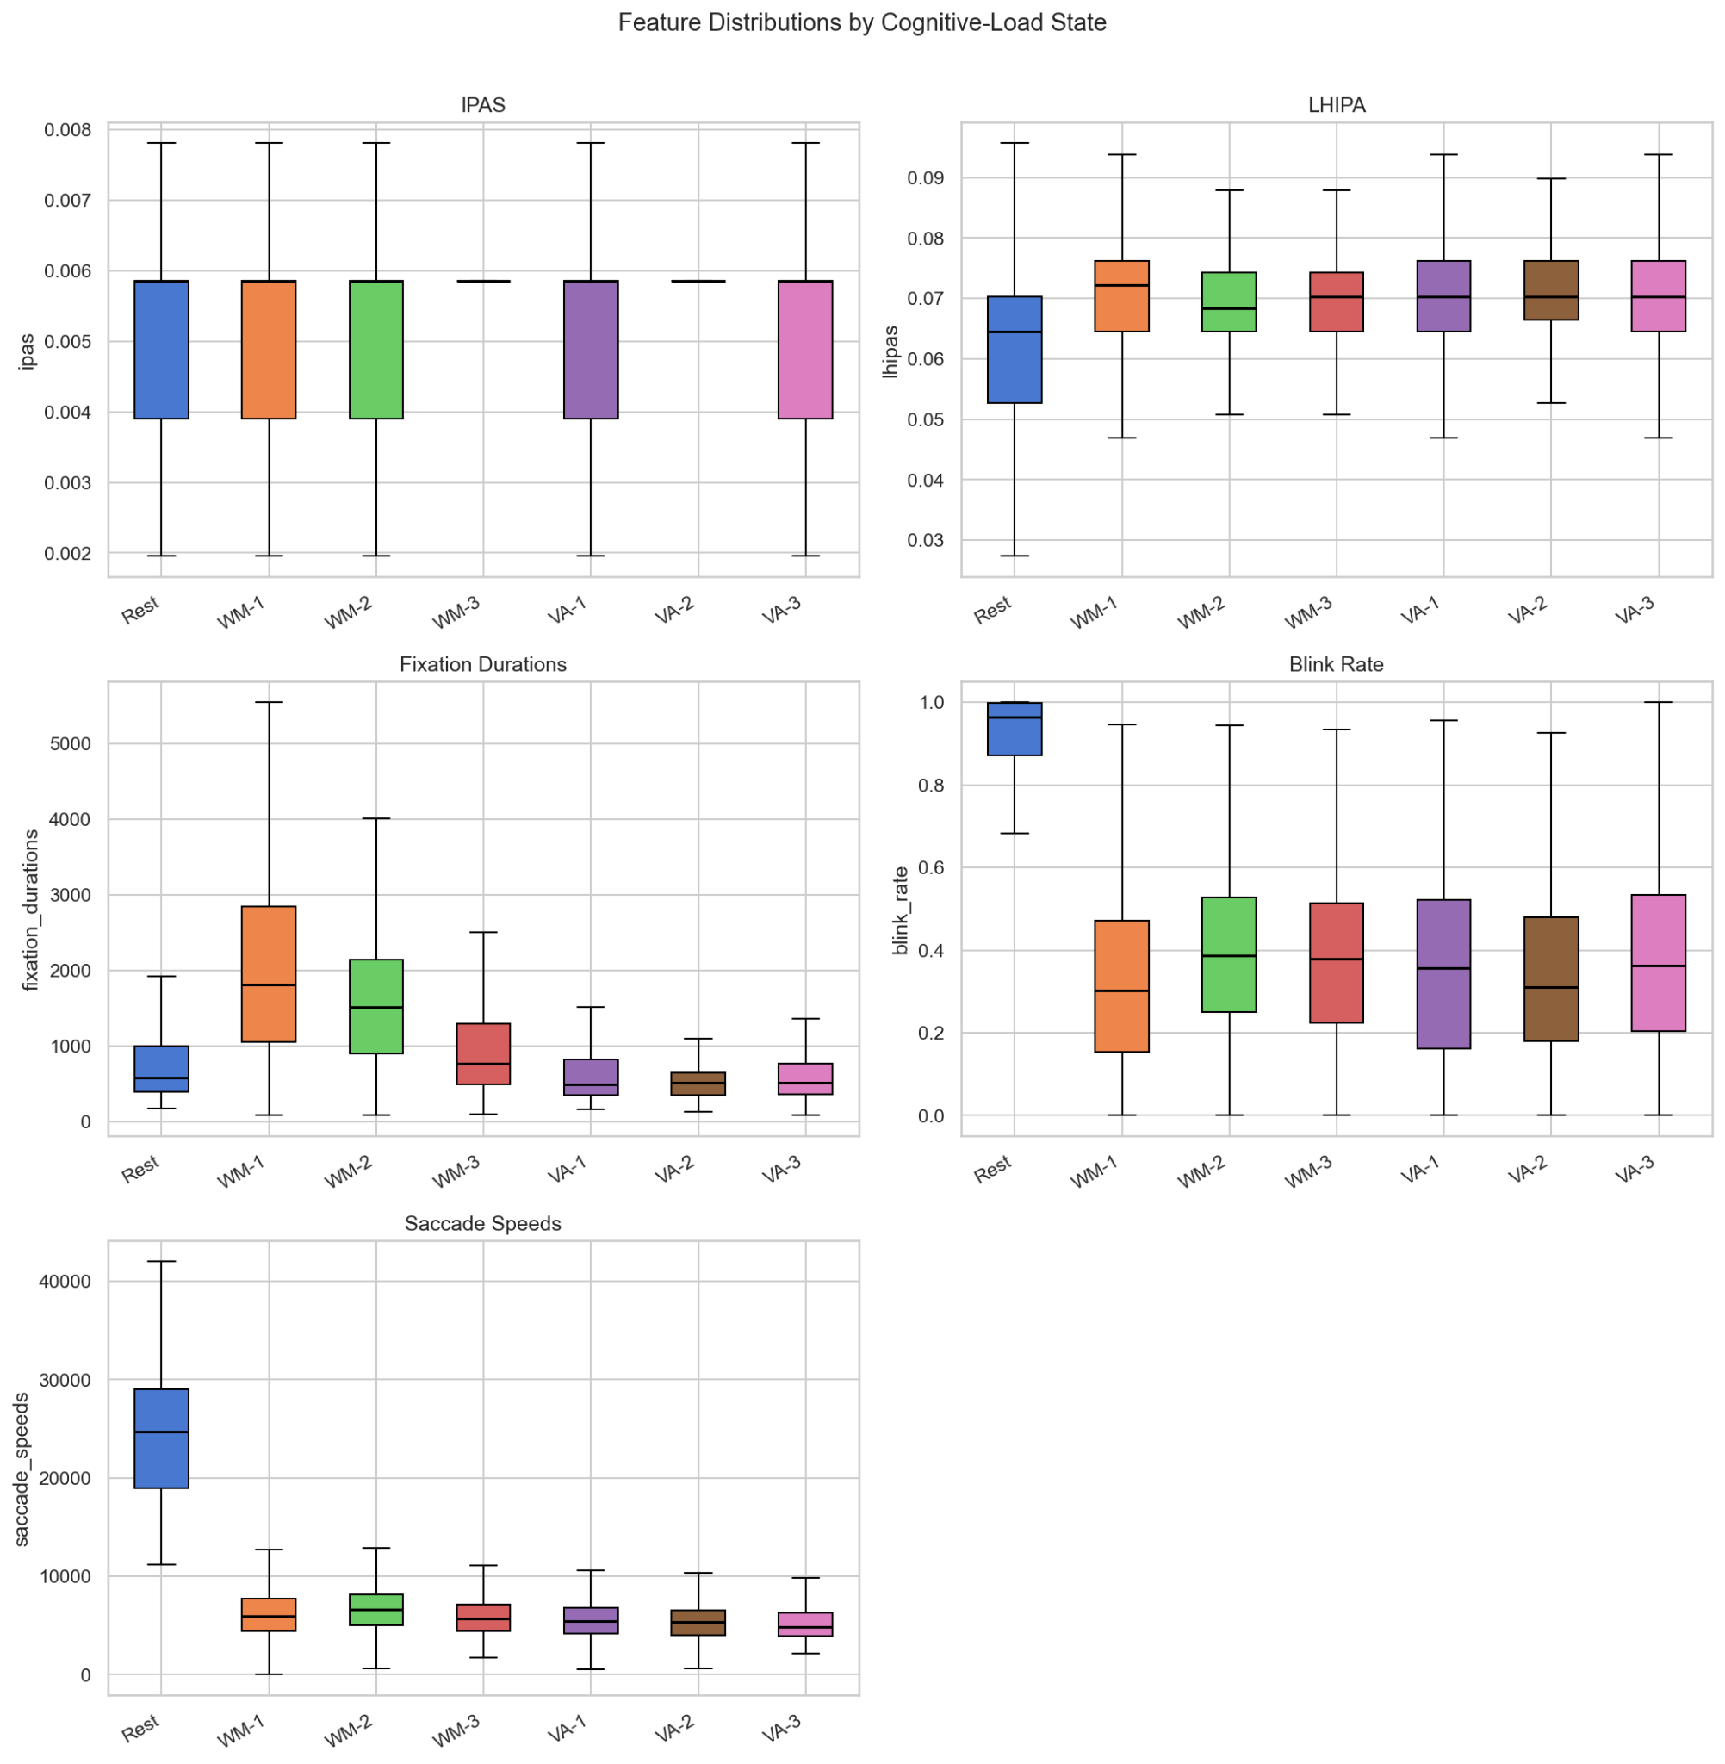
Feature Discriminability
Analysis via box plots reveals significant shifts in feature medians between "Rest" and "Load" states.
Pupil Diameter: Expands significantly under any cognitive load.
Saccade Speeds: Show higher variance in high-difficulty VA tasks.
IPAS: Clear differentiation for working memory states.

Slide 13






Machine Learning Architecture
SVM & XGBoost
Random Forest
Standardization
Chosen for high-dimensional efficiency. XGBoost handles non-linear relationships in oculometric signals.
Ensemble method providing robustness against outliers in blink rate and gaze jitter.
StandardScaler applied to all features to ensure distance-based models (KNN) are not skewed.

Slide 14

Evaluating Generalizability
Time-Based Split
Participant-Level Split
Chronological 80/20 split. Tests if the model can predict later recordings of known participants.
4 random test participants, 17 training participants. Tests if the model can generalize to unknown individuals.
Highly optimistic results.
Realistic, hard evaluation.

Slide 15
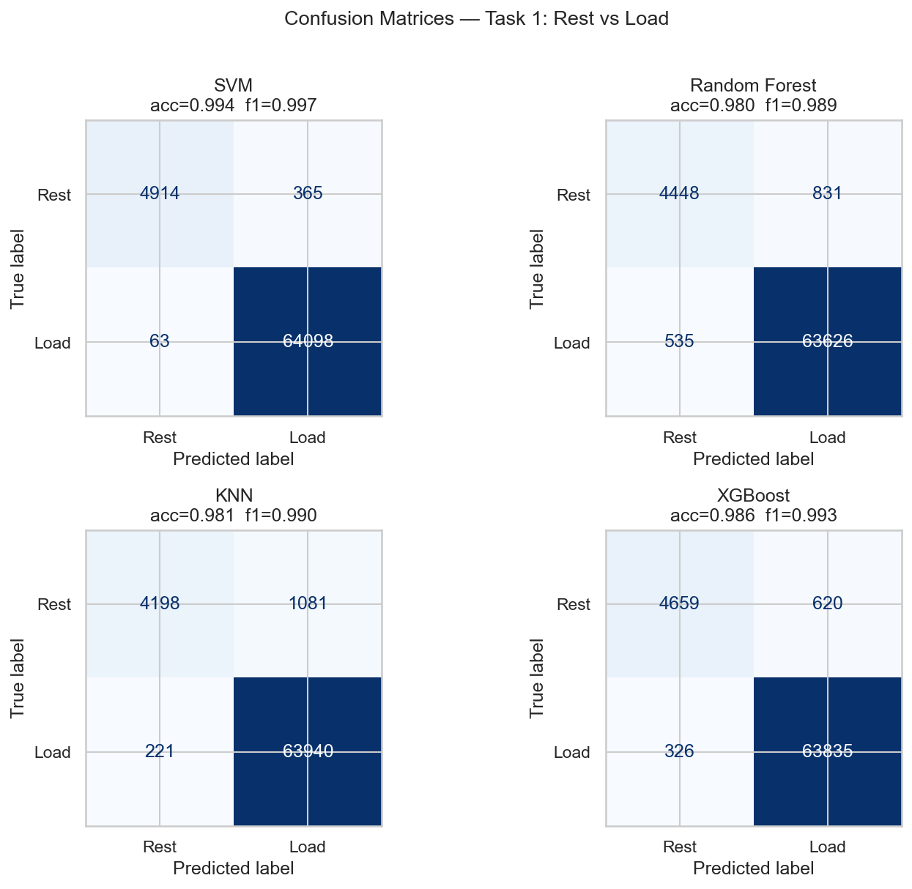
Task 1: Rest vs Load Baseline
Near-Perfect Detection
In a global time-based split, all models achieve >98% accuracy in detecting "any load" vs. "rest".
SVM: 99.4% Acc
XGBoost: 98.6% Acc
Conclusion: Detecting mental engagement from eye states is a solvable problem for modern ML.

Slide 16
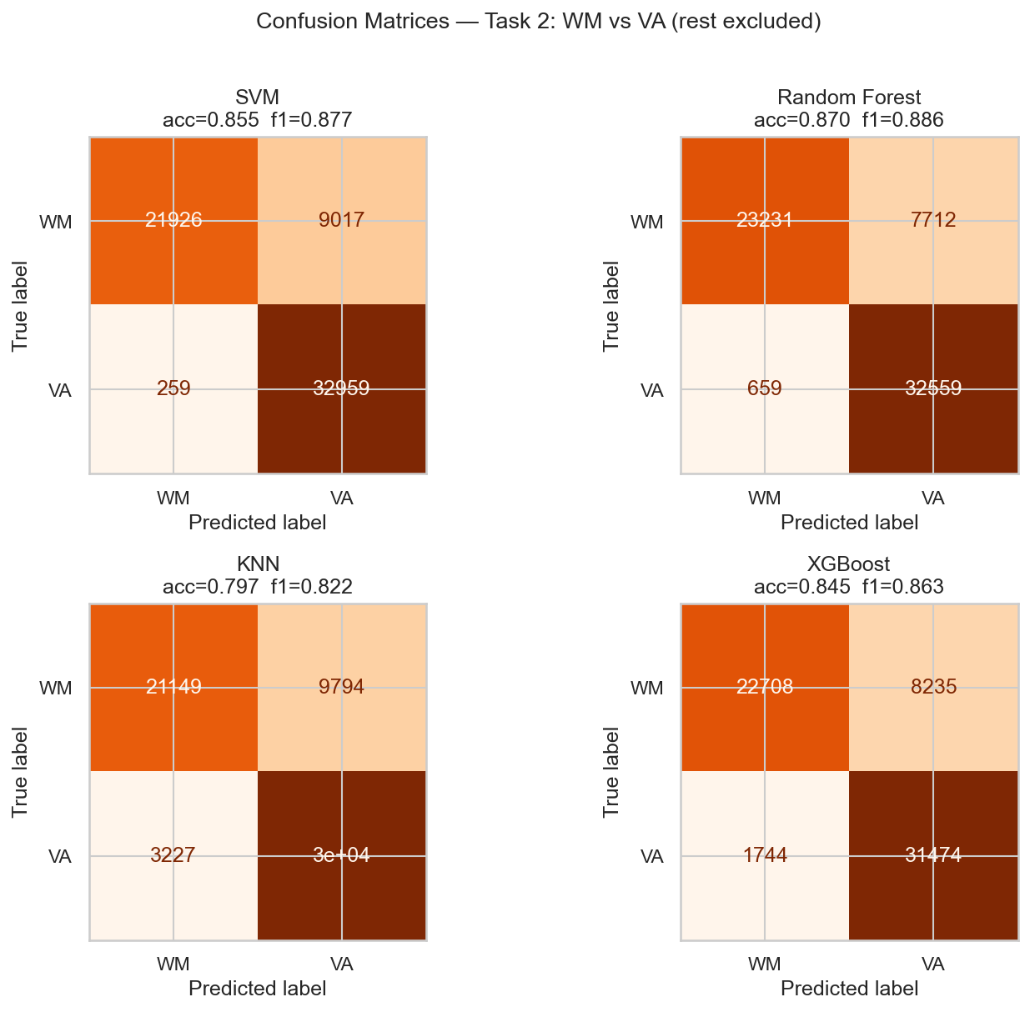
Task 2: WM vs VA Classification
Distinguishing Task Type
Differentiating between Working Memory and Visual Attention is a more nuanced challenge.
Random Forest: 87.0% Acc
SVM: 85.5% Acc
Significantly beats Jin et al. (2025) baseline of 62.3%.

Slide 17
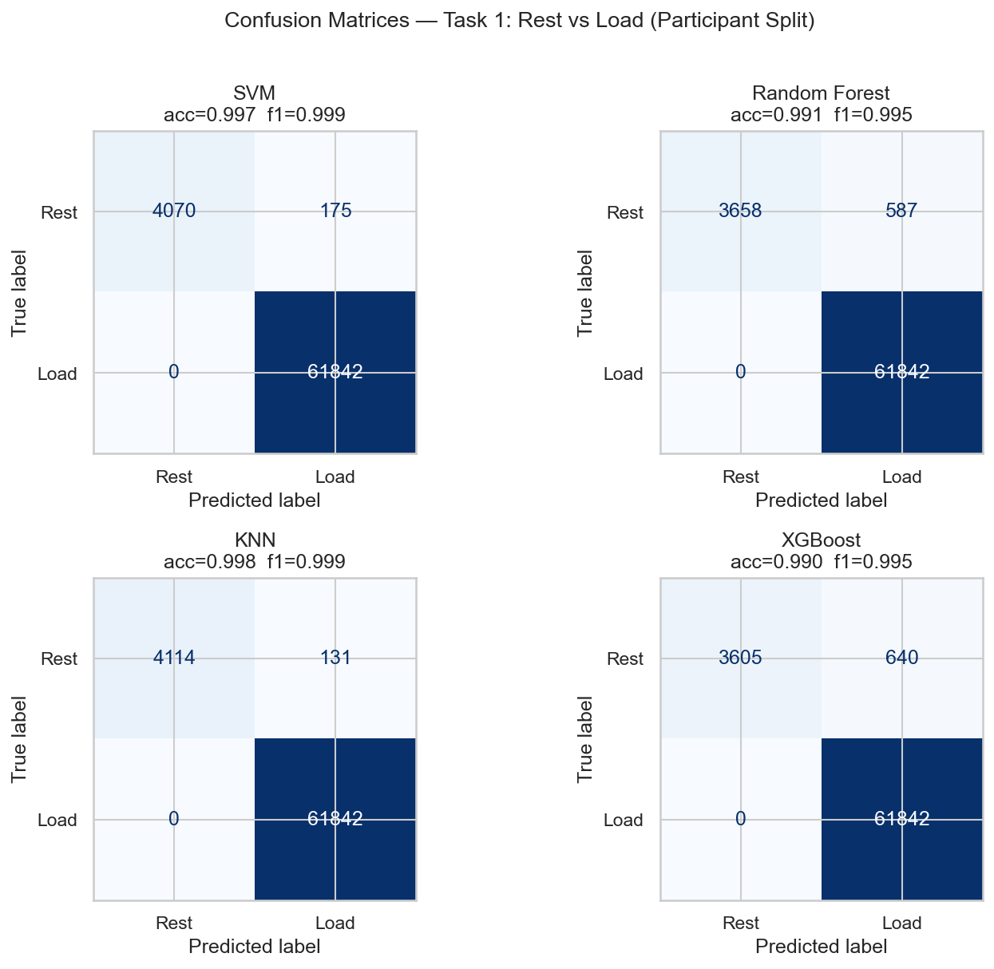
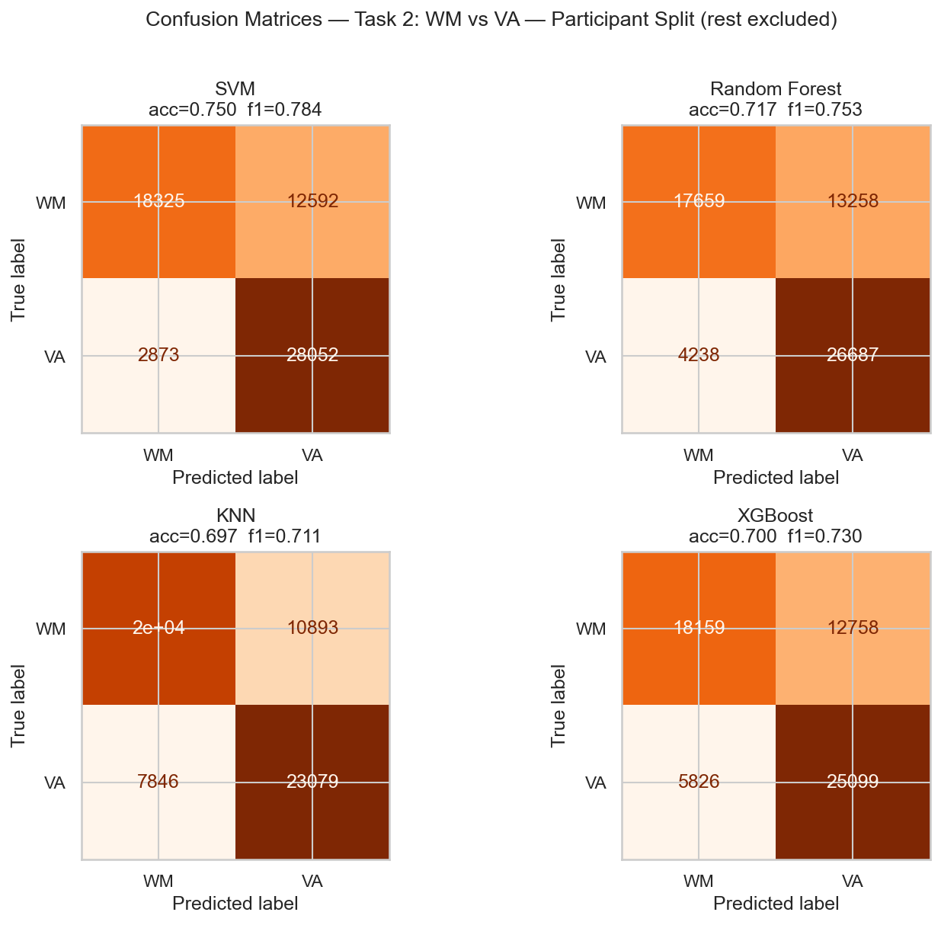
Cross-Subject Performance
The Cost of Generalization
When evaluated on new participants, performance drops as the model must overcome individual physiological variances.
Drop in WM vs VA: ~10-15%
SVM holds best stability at 75% accuracy.

Slide 18
Model Benchmarking Summary
Split Strategy | SVM Acc | RF Acc | XGB Acc | Benchmark
Global 80/20 | 85.5% | 87.0% | 84.5% | -
Jin et al. Split | 71.2% | 79.4% | 80.4% | 62.3%
Participant Split | 75.0% | 71.7% | 70.0% | -

Slide 19
Conclusion & Questions
75%
Summary
Oculometric signals (LHIPA, IPAS) are strong predictors.
Participant-level splits are essential for realistic HCI.
Future Work: Real-time adaptive UI intervention based on these models.
Cross-Subject Accuracy
Reliable decoding of cognitive type is feasible even for users unseen by the model.

Slide 20
References
[KKZ+23] Kosch et al. "A survey on measuring cognitive workload in HCI." ACM Computing Surveys, 2023.
[EKD+25] Ekin et al. "Prediction of Intrinsic and Extraneous Cognitive Load with Oculometric and Biometric Indicators." Scientific Reports, 2025.
[JBX+25] Jin et al. "Decoding Cognitive Load: Eye-Tracking Insights into Working Memory and Visual Attention." ETRA '25, 2025.
[MEVS26] Molloy et al. "Machine Learning Methods for Cognitive Load Analysis and Classification in Aviation." IJHCI, 2026.

